Slide 1
Covid-19 Case and Vaccination Analysis
Group 3: Christa Andersen, Sabina Azim, Natasha Vij
Cloud Computing, Fall 2021

Slide 2
Overview
Project Introduction/Definition
Project Goals
Expected Outcomes
Data Source
Project Architecture
Logical Architecture
Data Flow
Project Implementation
Quicksight Overview
Demonstration of project inputs and outputs

Slide 3
Project Introduction

Slide 4
Scope of the Project
Project Goals
Develop a data science project that utilizes AWS services that we have covered in class, as well as new services
Utilize skills learned in other data science classes in conjunction with AWS (Data Mining, HTML, CSS)
Expected Outcomes/Features
A static website hosted via S3 to display the case and vaccination trends of Covid-19 in an attractive and user-friendly manner

Slide 5
Background: COVID-19 Data Trends
The first suspected case of COVID-19 was identified in Wuhan, China in December 2019
Since then, there have been 48 million confirmed cases and 777,000 confirmed deaths caused by COVID-19 worldwide
There are a number of organizations that track COVID-19 data
United States: Center for Disease Control, John Hopkins University
Worldwide: Our World in Data, World Health Organization

Slide 6
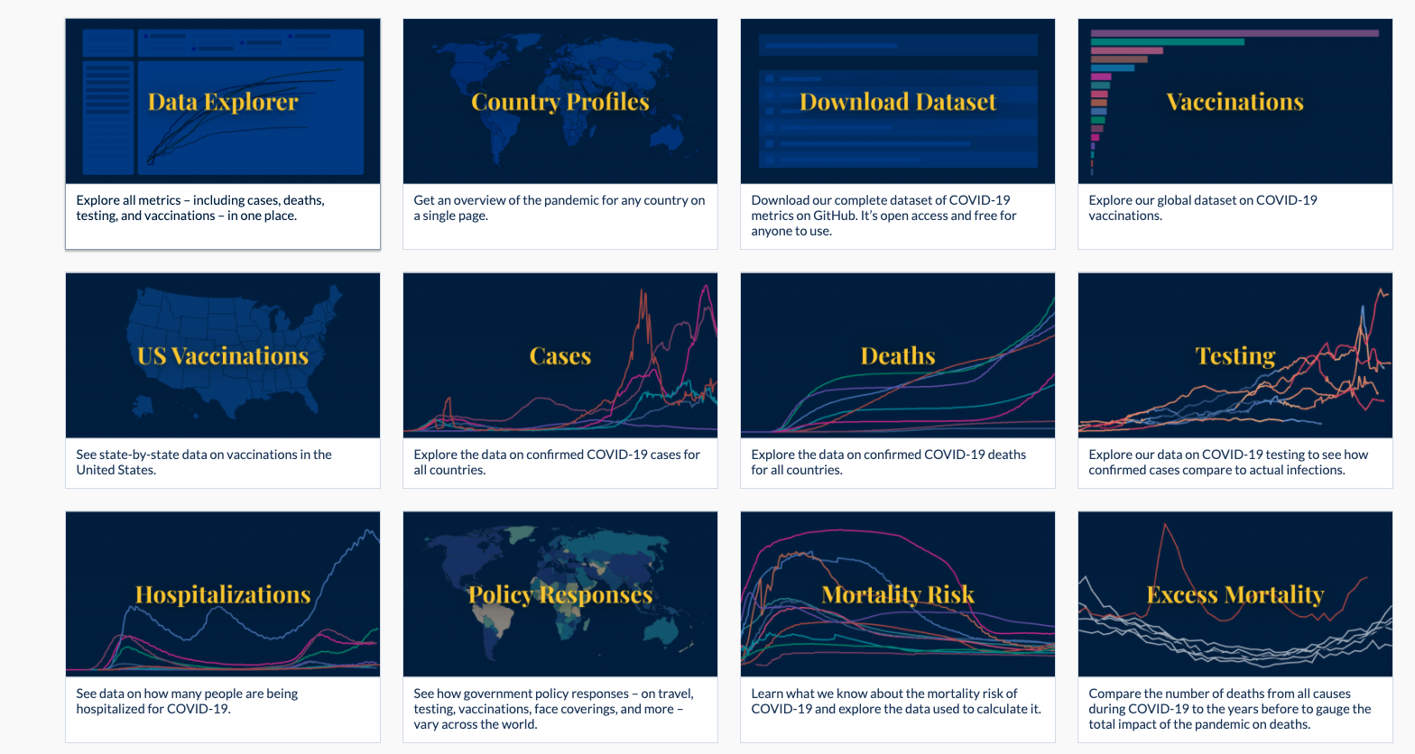
Data Sources
Dataset obtained from Our World in Data

Slide 7
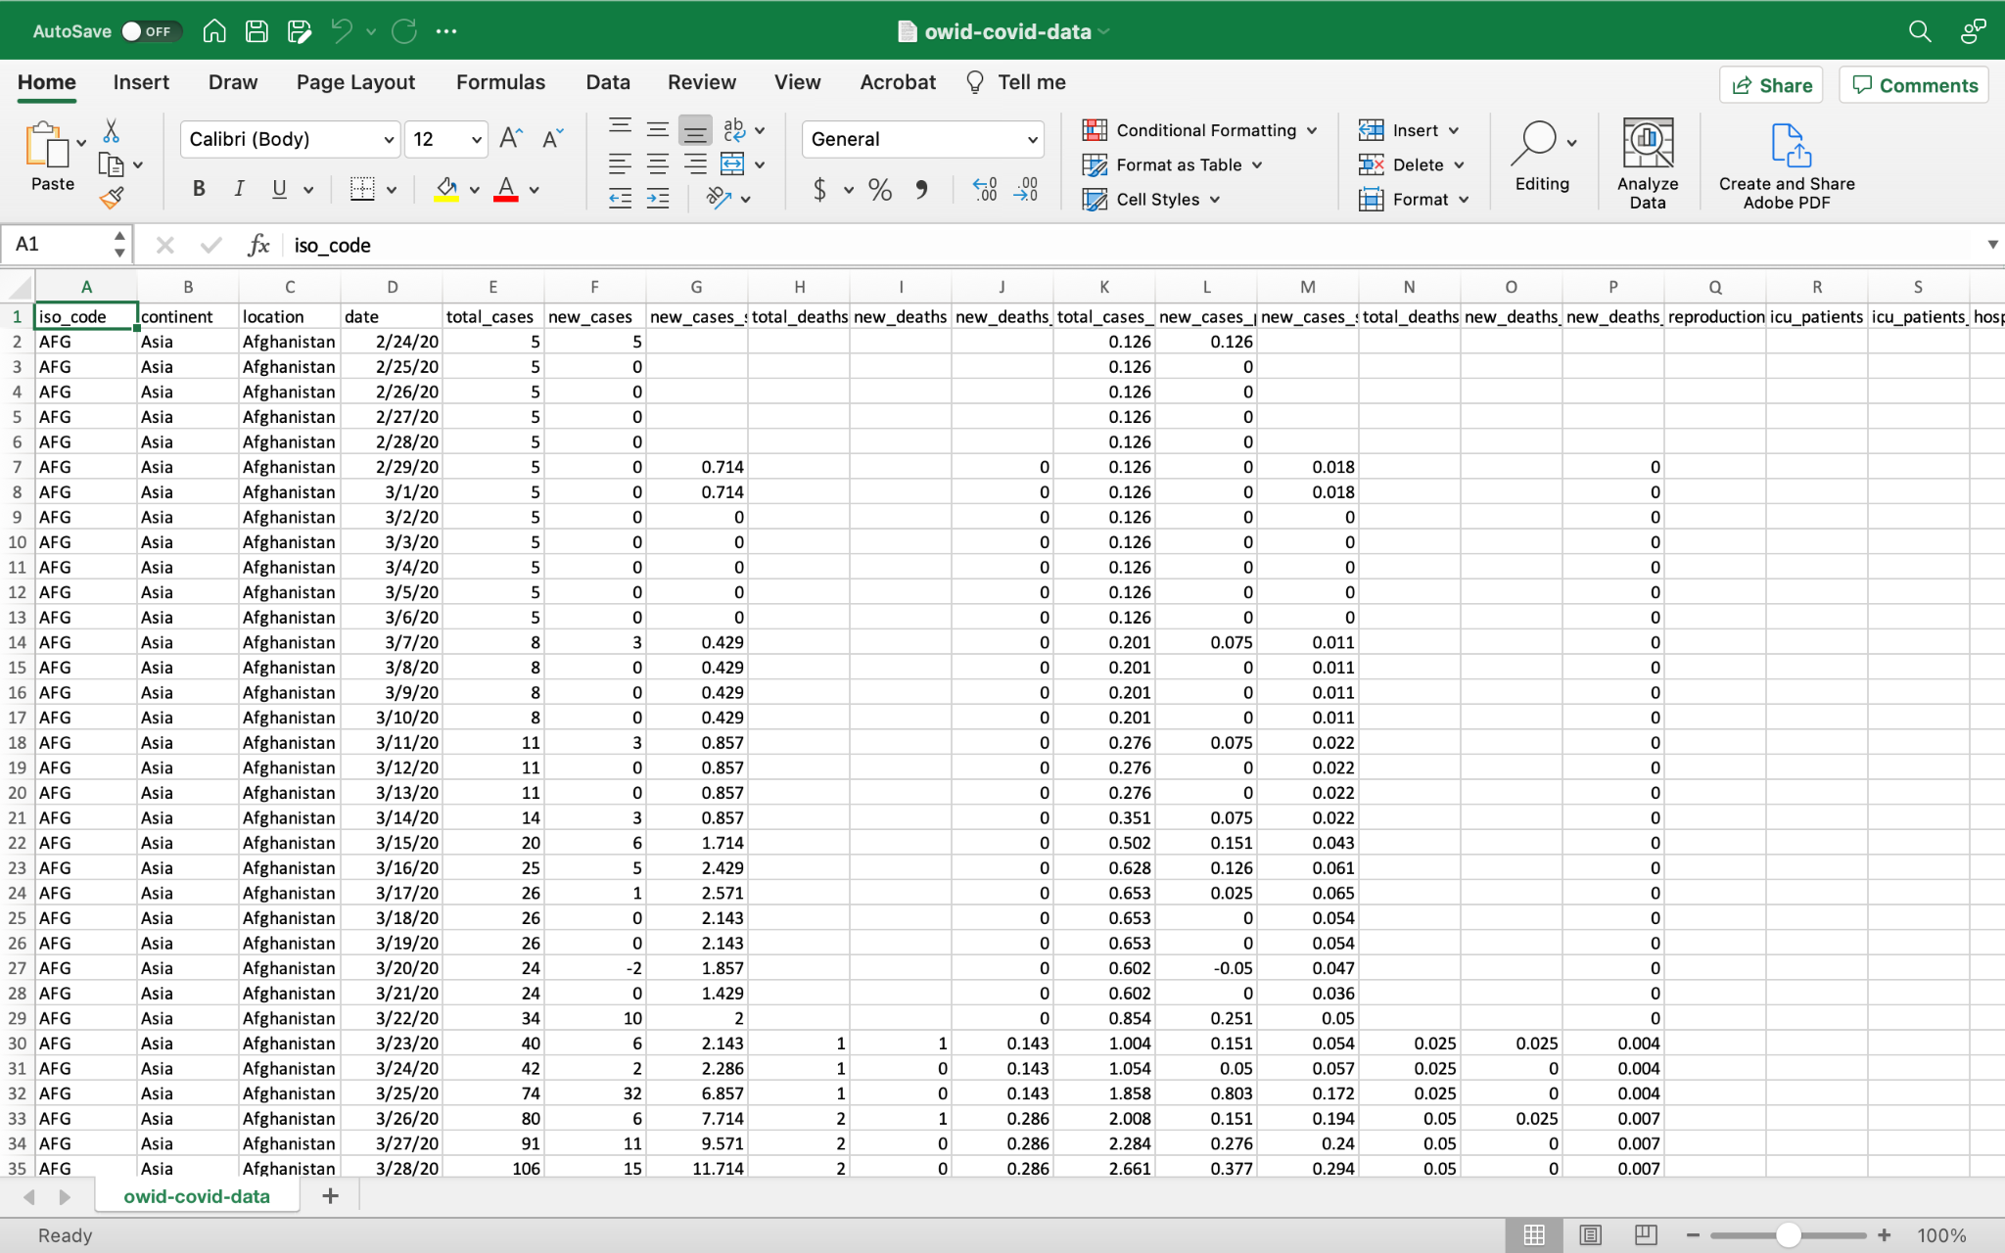
Sample dataset
Daily data for each country between 2/24/2020 and last update (11/28/2021)
Includes demographic variables

Slide 8
Project Architecture

Slide 9




AWS Architecture
Create Bucket
Create Dashboards
Amazon Identity Access Management (IAM)
Amazon S3
Amazon QuickSight
Host visuals on S3 Static Website
Policies: AdministratorAccess (AWS Managed), AWSQuickSightEmbedding (Customer Managed)

Slide 10







Data Flow
+
Download raw data as Excel file from Our World in Data
Clean raw dataset in Excel to prepare for import into QuickSight
QuickSight uses SPICE to perform rapidly import data and perform queries
Create visuals and dashboards to be hosted on website
Use HTML & CSS to format and style web pages
Upload HTML & CSS files into S3 bucket to be hosted on static website

Slide 11
Project Implementation

Slide 12
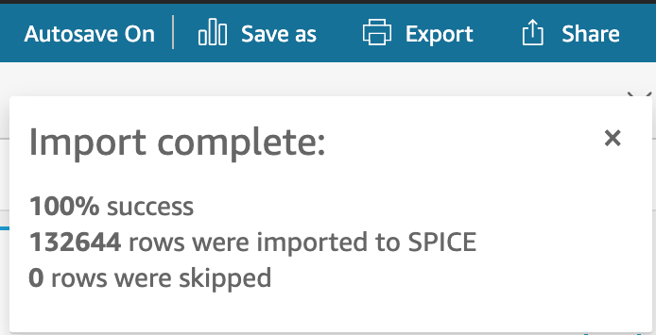
Introduction to Quicksight
AWS version of a visualization tool
Standard vs. Enterprise Edition
Enterprise edition needed for embedding
Pay-per-use model
$0.30/session, up to $5.00/reader/month
Dataset imported to SPICE (Super-fast, Parallel, In-memory Calculation Engine)

Slide 13
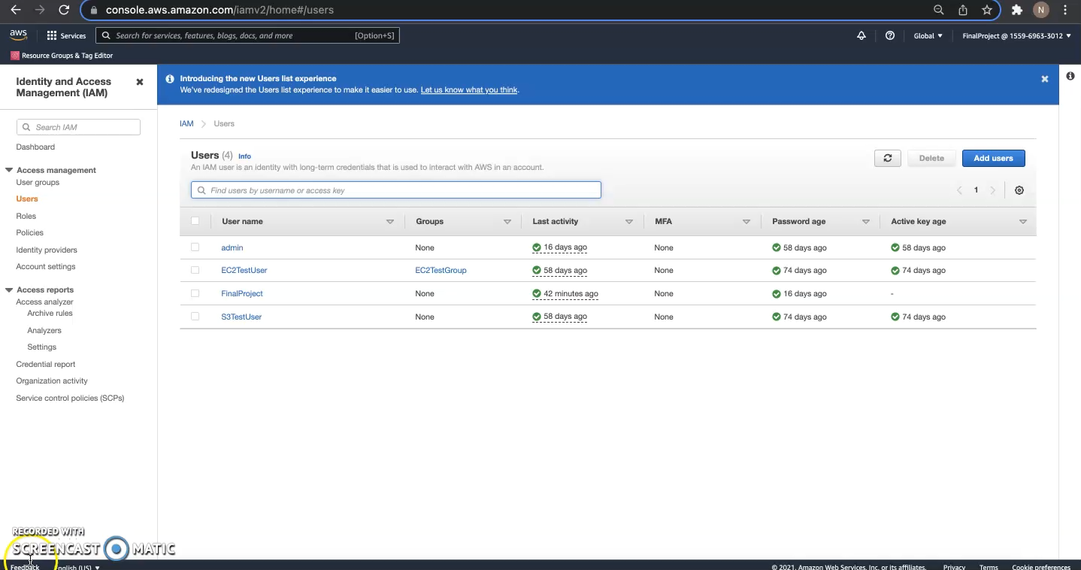
S3 Static Website Demo
COVID-19 Dashboard Website

Slide 14
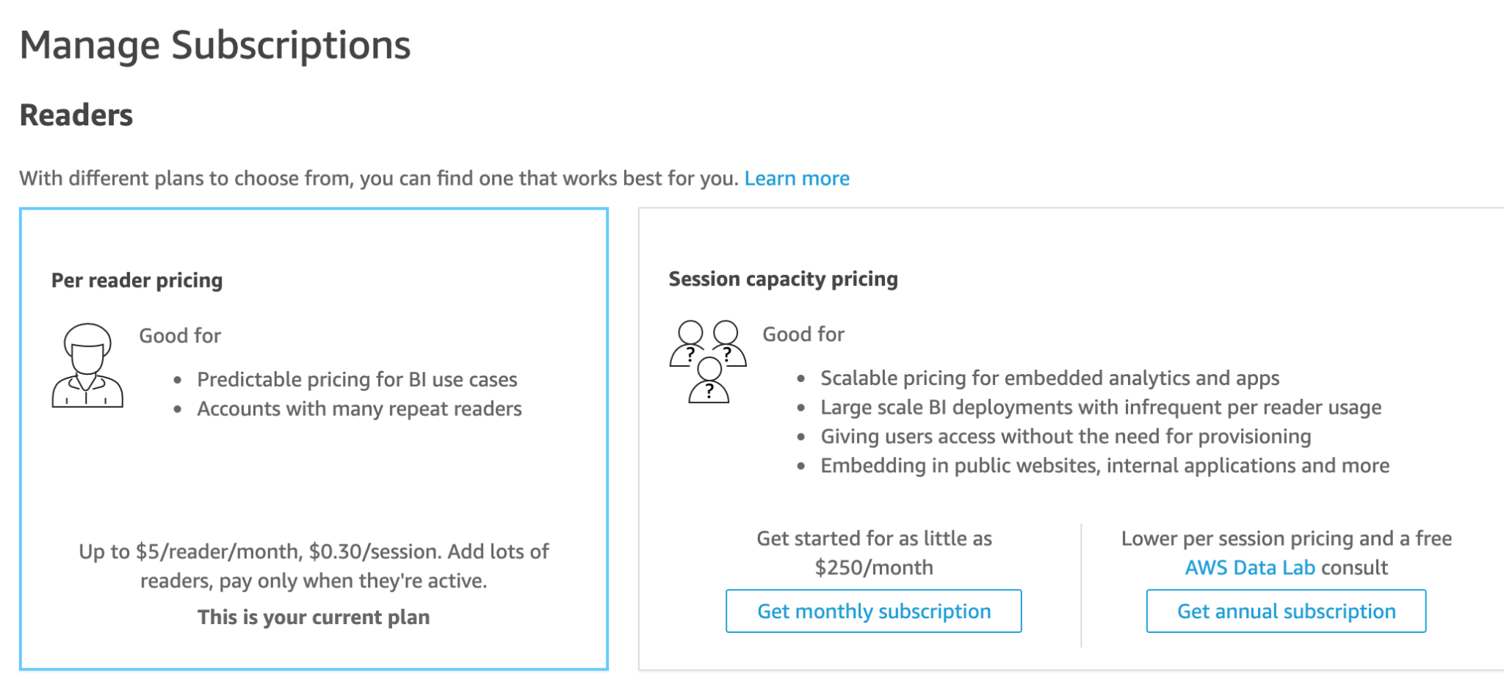
Overall Thoughts on Quicksight
Similar to BI tools such as Tableau
Importing data and creating visualizations
Difficult to embed dashboards into publicly hosted websites
Cost differences
Ability to integrate SageMaker Models is a plus - future goal for this project
To learn more about AWS QuickSight, the following LinkedIn Learning course is a great resource!
Learning Amazon Web Services (AWS) QuickSight

Slide 15
Questions? More information about this project can be found on our GitHub project page.

